Slide 1
Pneumonia Detection using
Mask-RCNN and COCO Weights
A Deep Learning Approach
Md Asaduzzaman Jabin
Graduate Student
School of Electrical and Computer Engineering
University of Georgia, GA-30602
Email: mj71006@uga.edu

Slide 2
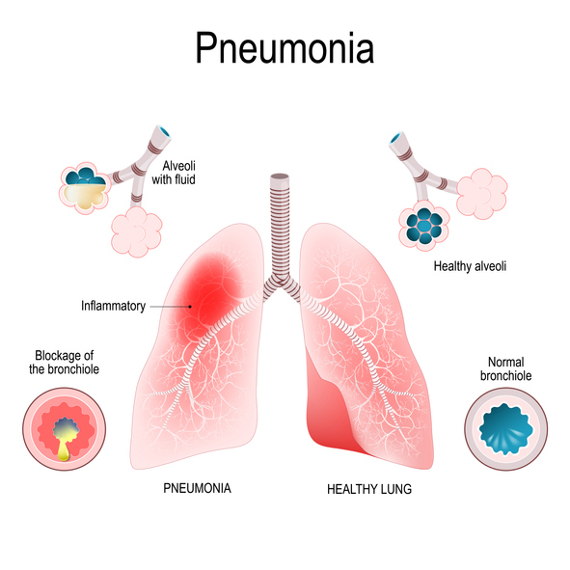
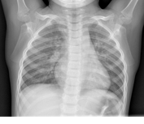
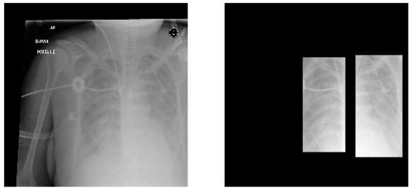
Introduction
Research Motivation
In US, near 1 million adults ask emergency care in a hospital and 50,000 died.
Early detection and monitoring during all 4 stages of pneumonia will save life.
Detects the area that contains Pneumonia in an x-ray image
Problem Statement
Pneumonia Detection is overall an image segmentation and detection problem
Data Set
Source: RSNA Pneumonia Detection Challenge (2015) (https://www.kaggle.com/competitions/rsna-pneumonia-detection-challenge/data)
Data Set size: 29.5 K (Train: 26.7K Test: 3K)
Data: Dicom Image data and labels saved in .csv file
Data Labels: 6 attributes (P_id, x-min, y-min, width, height, Target)
Normal
Pneumonia Detected
Pneumonia
Code Ref: https://www.kaggle.com/code/ashishsingh226/car-detection-using-maskrcnn
mj71006@uga.edu

Slide 3
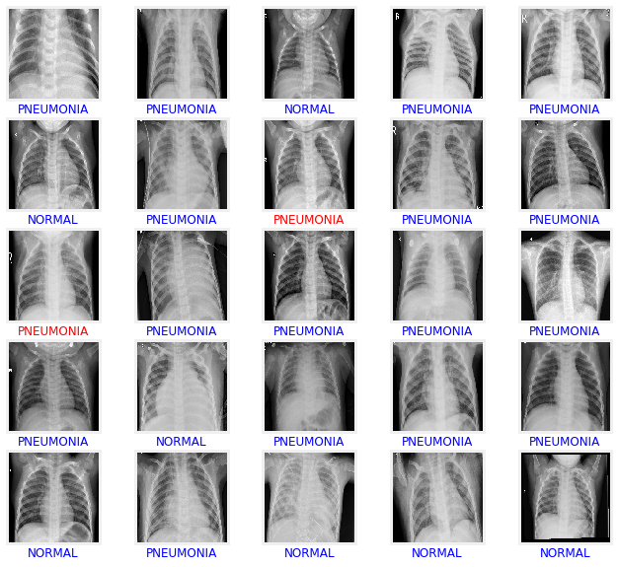
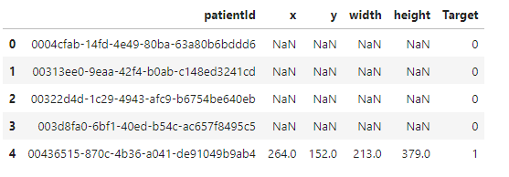
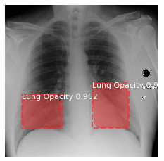
Data Set Preview
Pneumonia Detected
mj71006@uga.edu

Slide 4
Literature Review
K. He et al. (2020) mentioned M-RCNN that has shown promising results and less accurate detection for multiple position detection.
Yang et al. (2020), used VGG-16 with ImageNet, but could not handle various image augmentation
Girshick et al. (2021), used M-RCNN with ResNet-50, takes 2 staged detection and slow training process
Lin et al. (2021), used pre-trained ResNet-101 with RPN network. Computationally heavy and did not check ImageNet and COCO weights.
Rajaraman et al. (2021) used M-RCNN with COCO weights on 5000 samples, but did not test on large dataset.
Issues:
Slow
Trained on small dataset
Could not handle multiple detection
Could not handle image augmentation
In this project, we used M-RCNN with COCO weights with ResNet-50 backbone with transfer learning approach
https://www.kaggle.com/code/zzamanasad359/pneumonia-detection-using-mask-rcnn-and-coco
mj71006@uga.edu

Slide 5
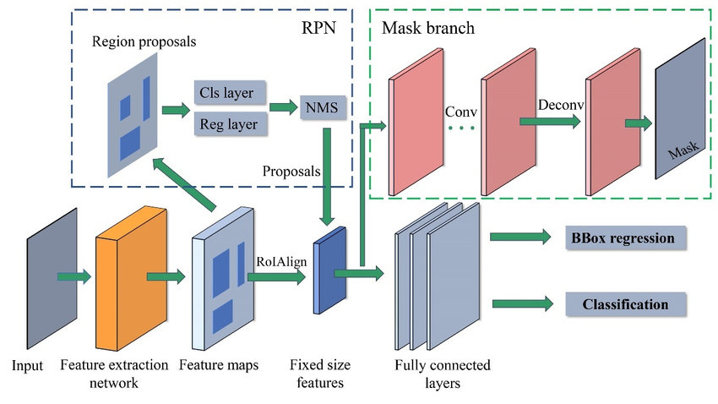
M-RCNN with COCO Overview
M-RCNN (2017)→
A two-stage object detection model
A Region Proposal Network (RPN) to generate candidate object regions, which are then classified and segmented using a convolutional neural network (ResNet-101).
M-RCNN with the COCO (Common Objects in Context) dataset contains over 330,000 images and more than 2.5 million object instances labeled with segmentation masks.
1. Data Annotation
2. Load the data
3. Load pre-trained weights
4. Data Augmentation
5. Preprocessing
6. Model Training
7. Model Tuning
8. Result
Object Detection Workflow
Schematic Diagram of M-RCNN
mj71006@uga.edu

Slide 6
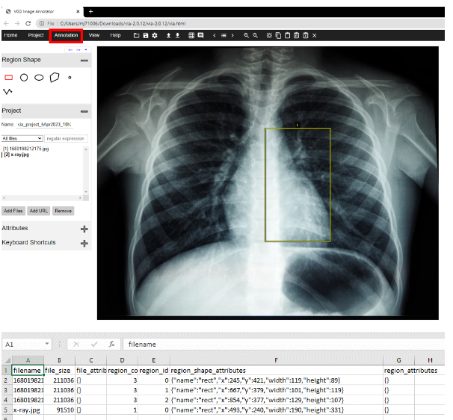
Object Detection Workflow
1. Data Annotation
Data Annotation via VGG Image Annotator
https://www.robots.ox.ac.uk/~vgg/software/via/
Among in 3k images, I used 100 images for data annotation
Returns 7 attributes (P_id, region_id, file size, x-min, y-min, width, height)
mj71006@uga.edu

Slide 7
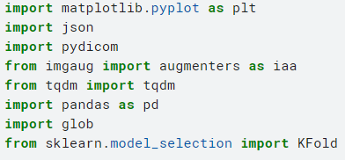


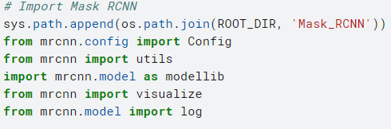

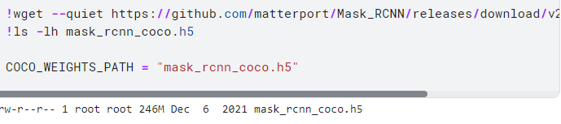
Object Detection Workflow (Cont.)
2. Load python packages
3. Load Pre-trained M-RCNN and COCO
mj71006@uga.edu

Slide 8

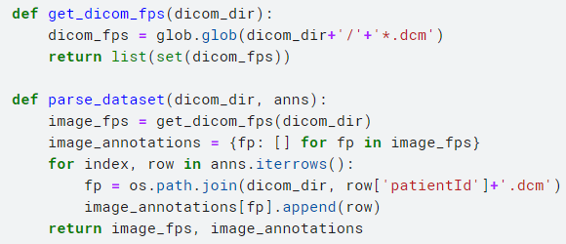
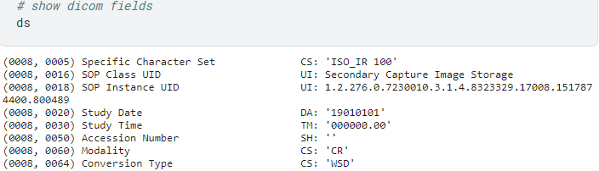

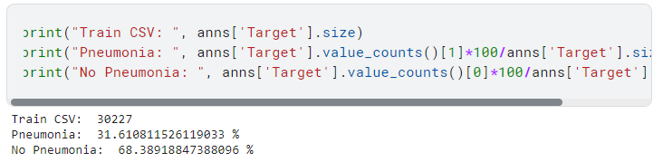
Object Detection Workflow (Cont.)
4. Load the data
5. Preprocessing: M-RCNN and COCO
Load Data Labels
a) Combine Annotation and Train Image
Load Images
Data Distribution
mj71006@uga.edu

Slide 9

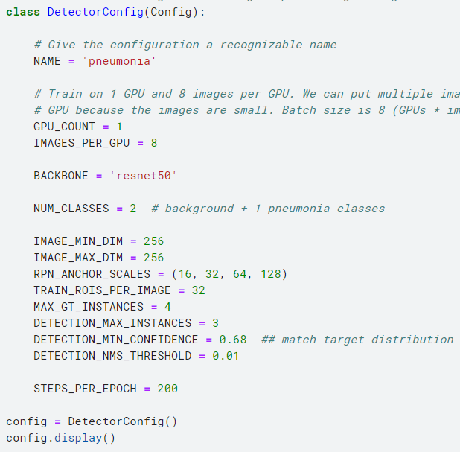
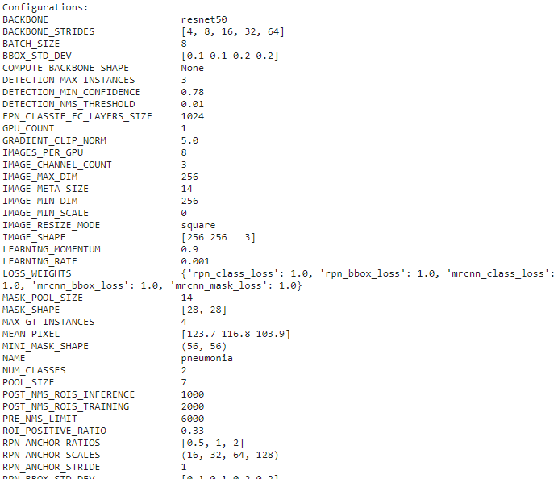
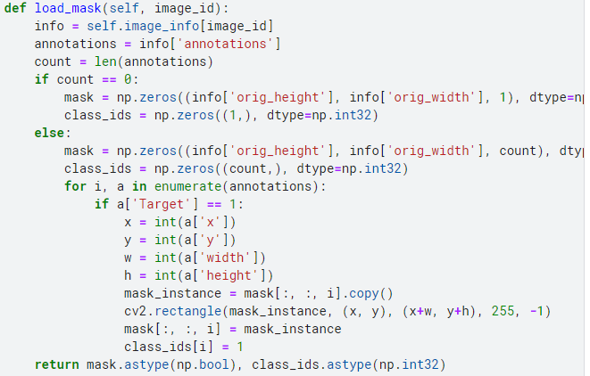
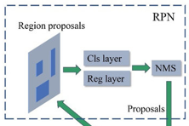
Object Detection Workflow (Cont.)
5. Preprocessing: M-RCNN and COCO
c) Define Image Data Processing Class
b) Define Model Configuration
mj71006@uga.edu

Slide 10
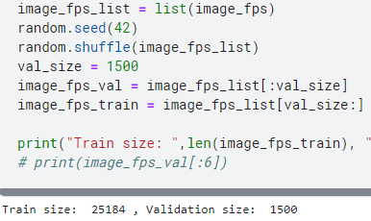
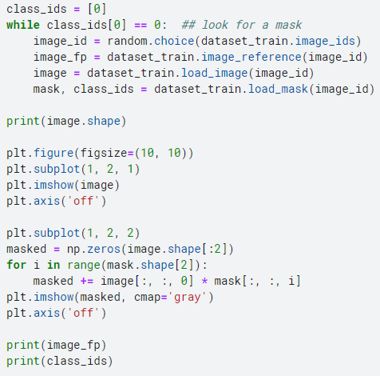
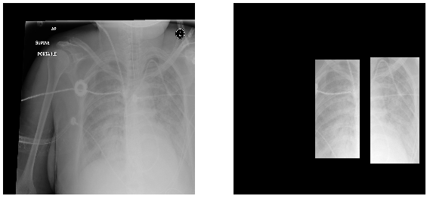
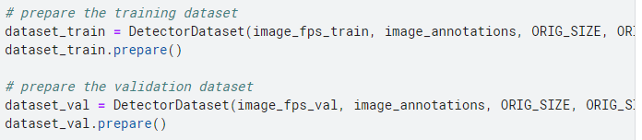
Object Detection Workflow (Cont.)
5. Preprocessing: Image data
5. Preprocessing: Image data
a) Data Split
b) Plot annotation with bounding box
Apply Annotation on validation and train
Pneumonia Targeted area
mj71006@uga.edu

Slide 11
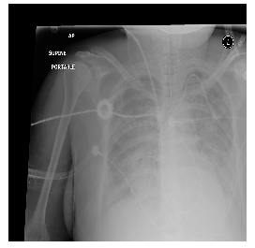
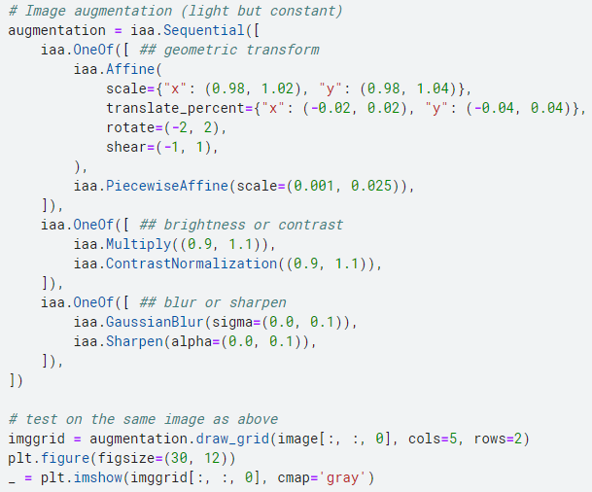
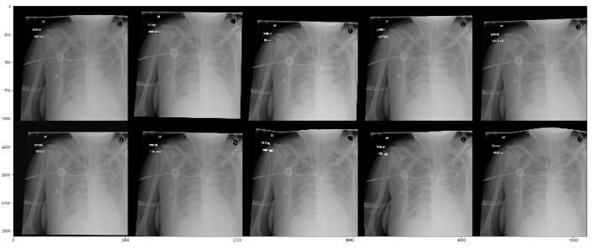
Real Image
Object Detection Workflow (Cont.)
6. Data Augmentation
mj71006@uga.edu

Slide 12
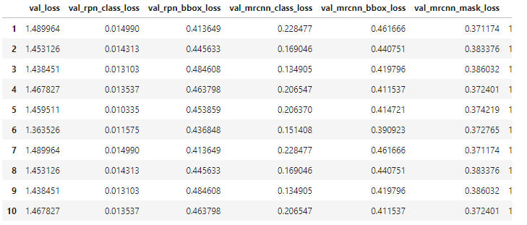
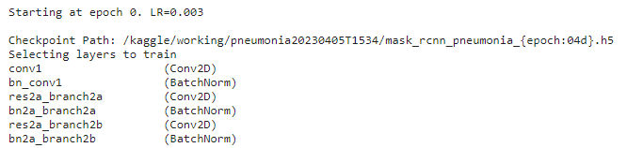
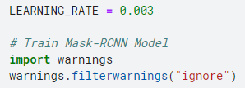
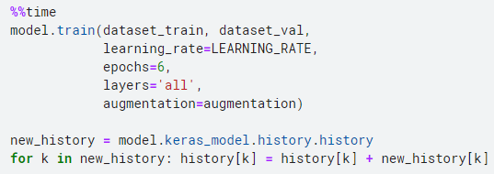
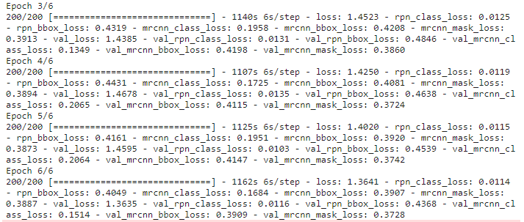
Object Detection Workflow (Cont.)
7. Train the model
Confidence Loss: This loss measures the confidence score assigned to each predicted bounding box, which indicates the probability of the box containing an object. The most commonly used confidence loss is the binary cross-entropy loss.
Class Loss: This loss measures the accuracy of the predicted class label for each bounding box. The most commonly used class loss is the softmax cross-entropy loss.
mj71006@uga.edu

Slide 13
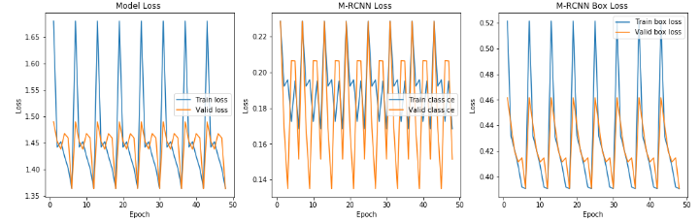
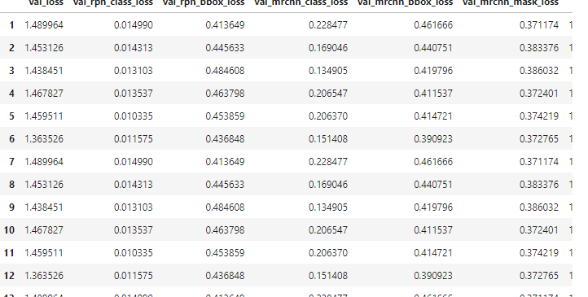
Object Detection Workflow (Cont.)
8. Evaluation
a) Plot train and Validation curve (LR = 0.003, Steps: )
mj71006@uga.edu

Slide 14
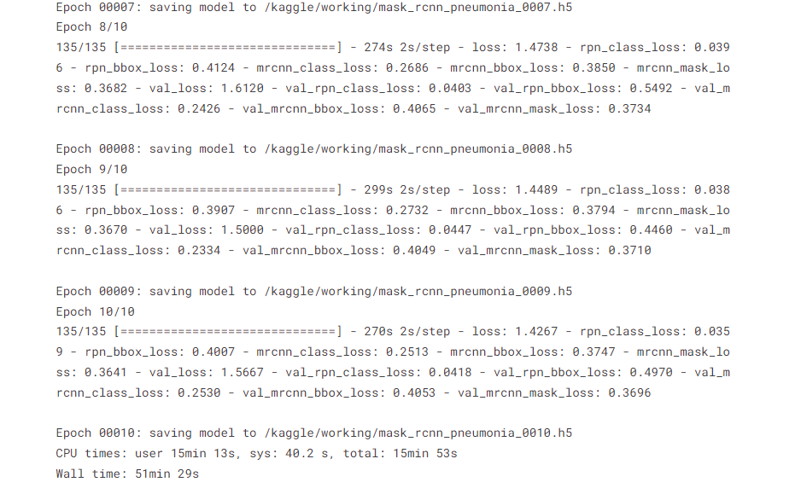
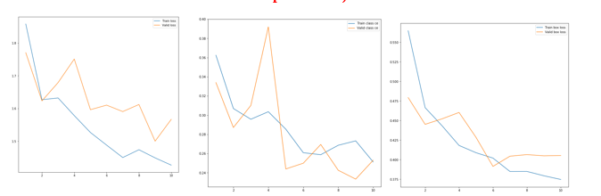
Object Detection Workflow (Cont.)
8. Evaluation
a) Plot train and Validation curve (Updated LR= 0.005, Steps = 135, epoch = 10)
mj71006@uga.edu

Slide 15
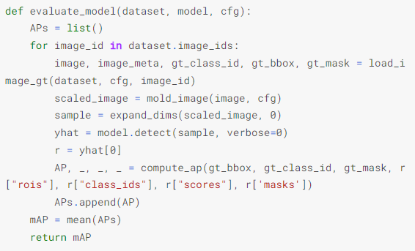
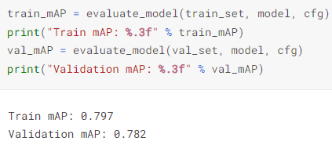
Object Detection Workflow (Cont.)
8. Evaluation
a) mAP avaluation
The mAP score is calculated by averaging the precision values at different levels of recall. Precision is the fraction of true positive detections among all the detections made by the model, while recall is the fraction of true positives that were correctly detected by the model out of all the ground-truth objects in the image.
mj71006@uga.edu

Slide 16
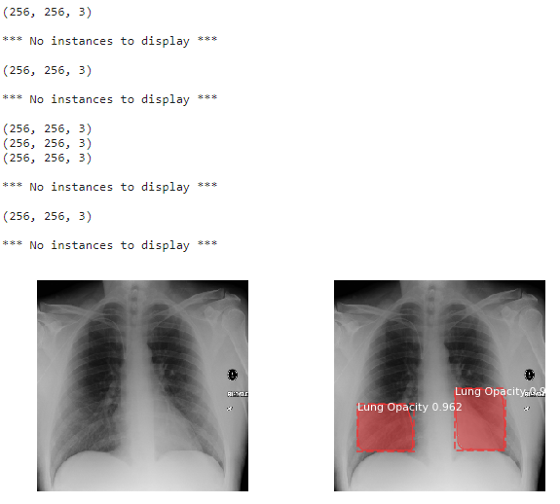
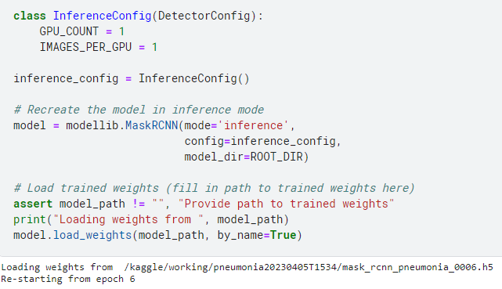
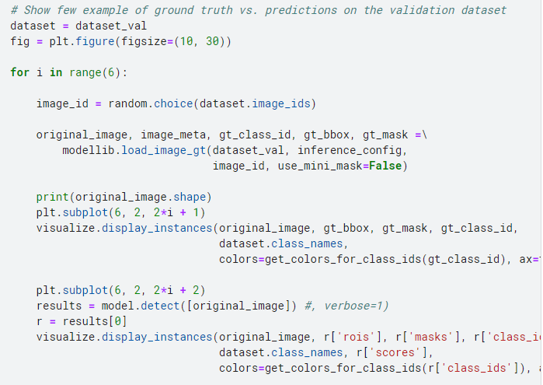
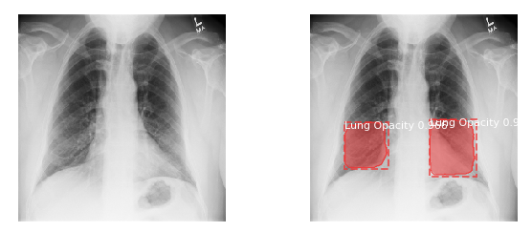
Object Detection Workflow (Cont.)
8. Evaluation
b) Deploy model for justifying validation data
mj71006@uga.edu

Slide 17

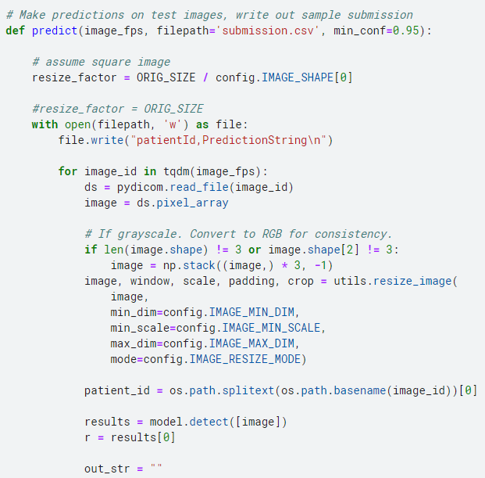
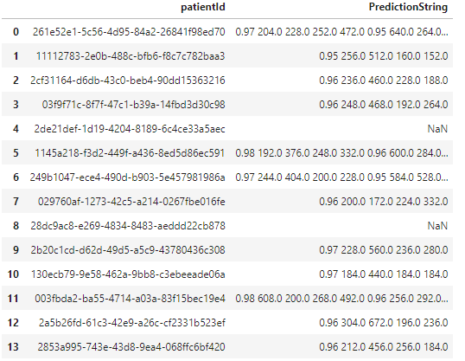
Object Detection Workflow (Cont.)
8. Evaluation
c) Test the model
Average Confidence score:
95% for all test data
Prediction result: Conf_score, x_min, y_min, width, height
mj71006@uga.edu

Slide 18
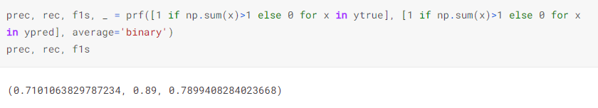
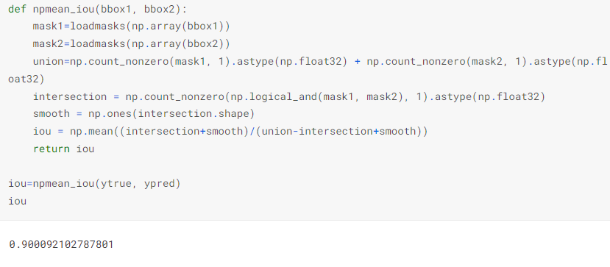
Object Detection Workflow (Cont.)
8. Evaluation
c) Test the model
Precision = 71%, Recall = 89%
F1 = 78%
IOU = 90%
mj71006@uga.edu

Slide 19
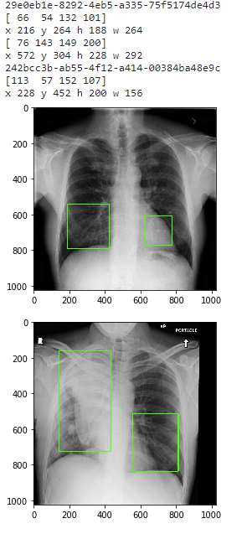
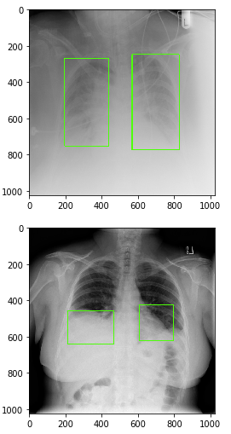
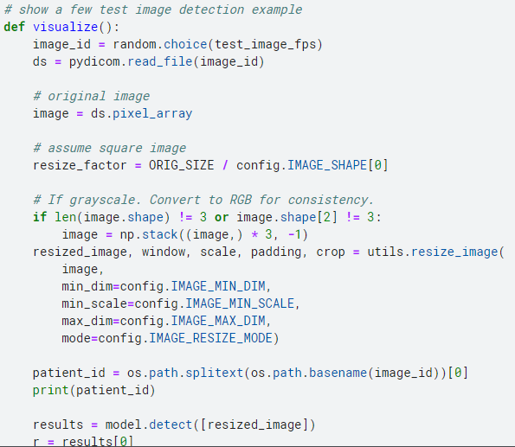
Object Detection Workflow (Cont.)
8. Evaluation
c) Visualize the test
mj71006@uga.edu

Slide 20
Summary
In this project,
26K samples used for train and validation and 3K used for testing
Image annotation is also described
Image augmentation is done
M-RCNN with COCO implemented with ResNet-50 backbone
Maximum RPN loss→ 0.011464, Bounding box loss→ 0.4049 total loss 1.36
mAP is: 80% (validation, train) (Target prediction)
Confidence score: ~95% (test)

Slide 21
Thanks!
Any Questions?

